Slide 1
NPComposer: An advanced platform for natural product generation methods
Final Presentation – ChemE 546
Shawn Ralyn, Juyoung Choi, Drew Levitt · University of Washington · 2026

Slide 2
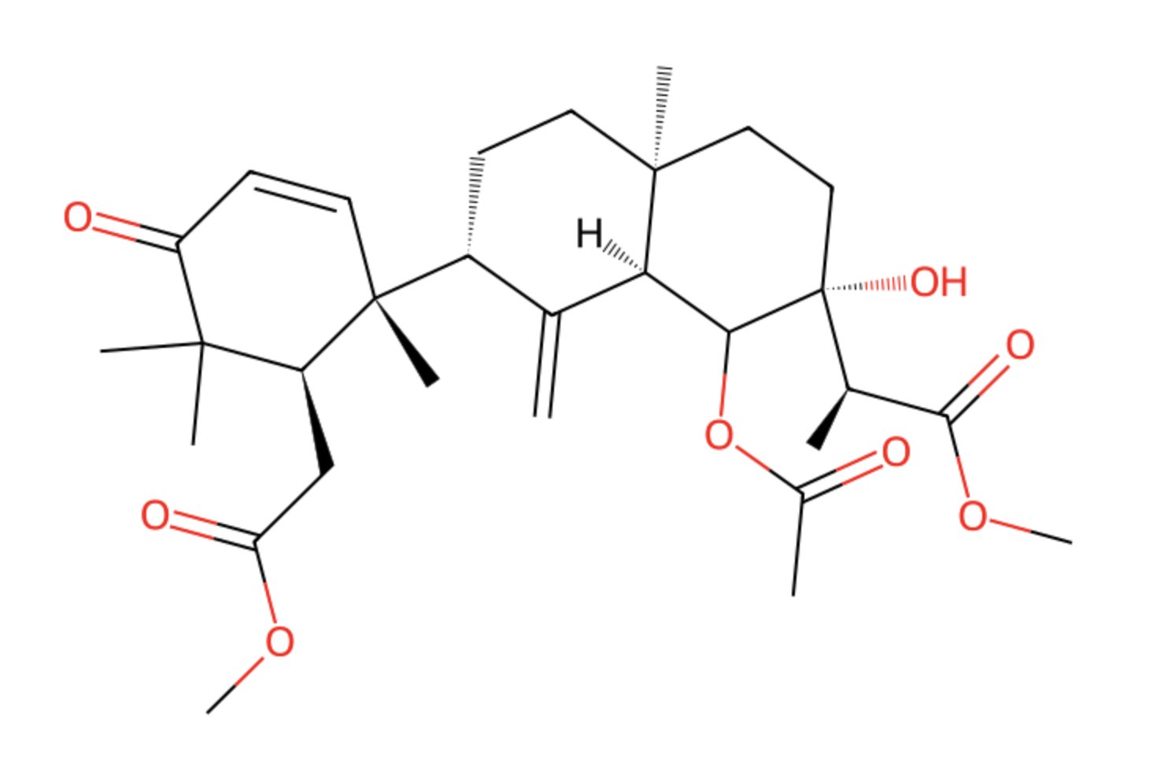
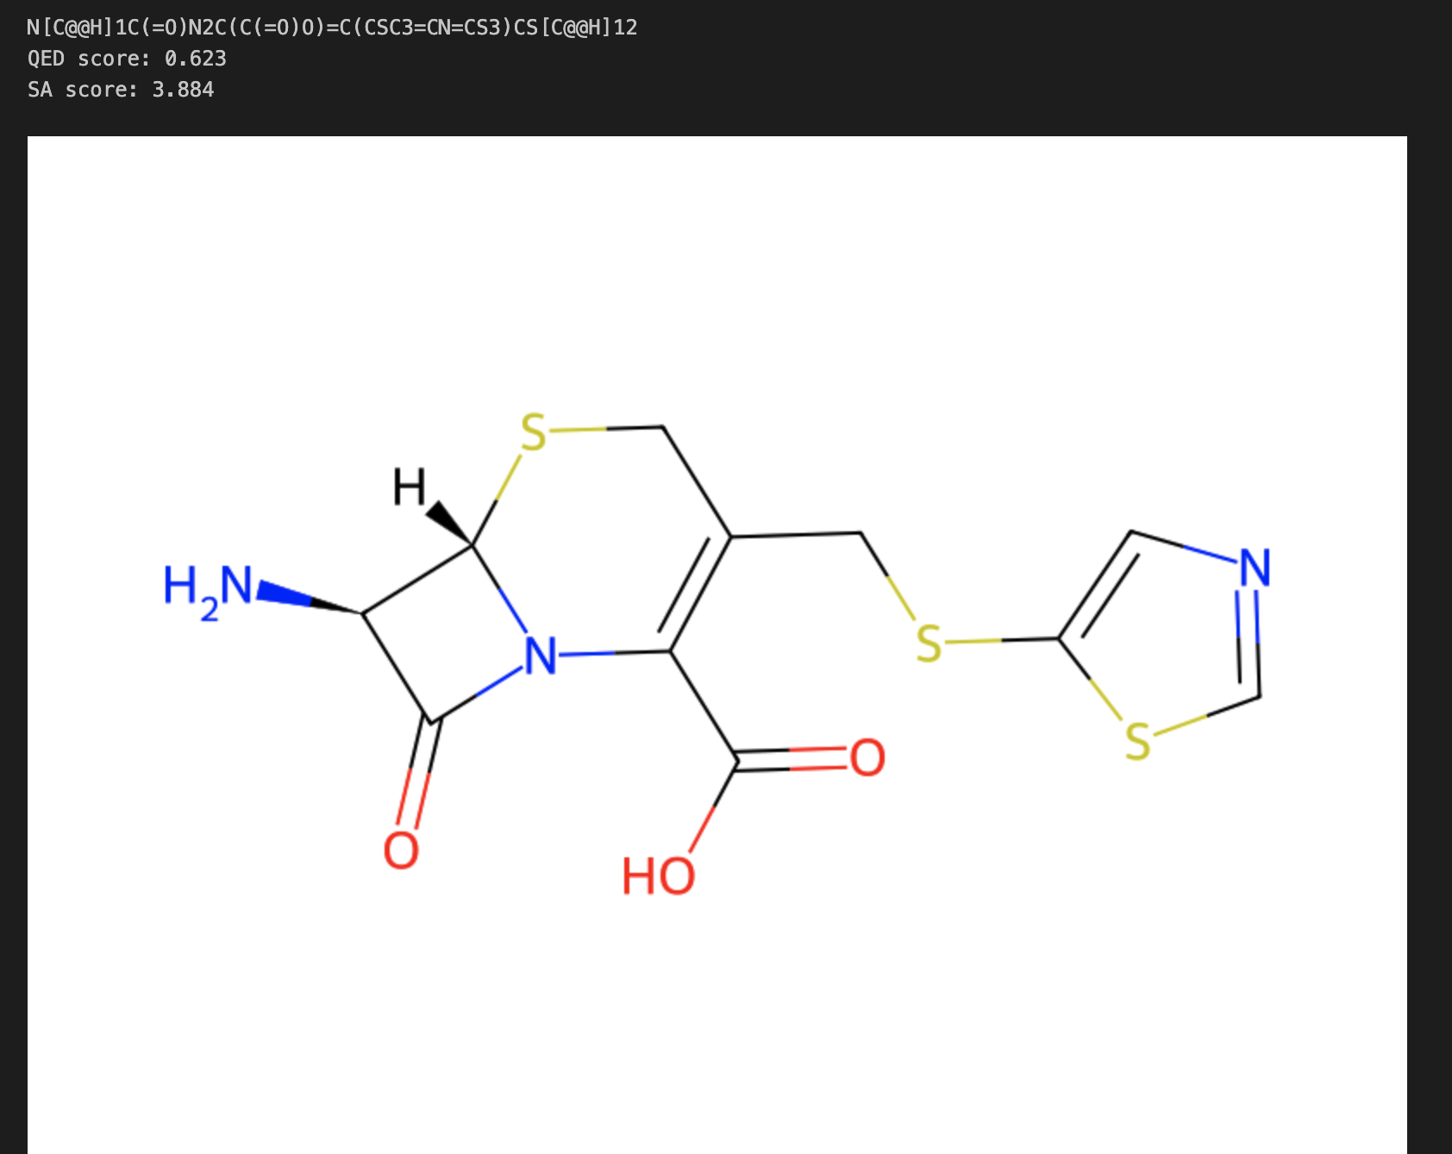
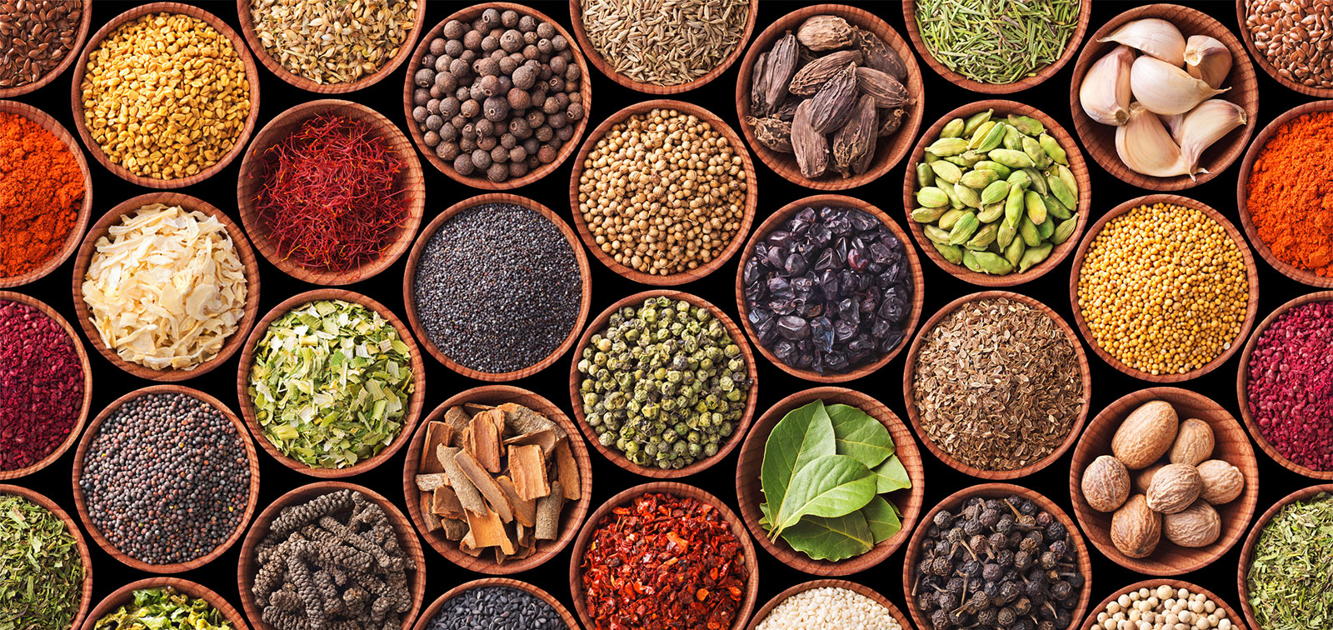
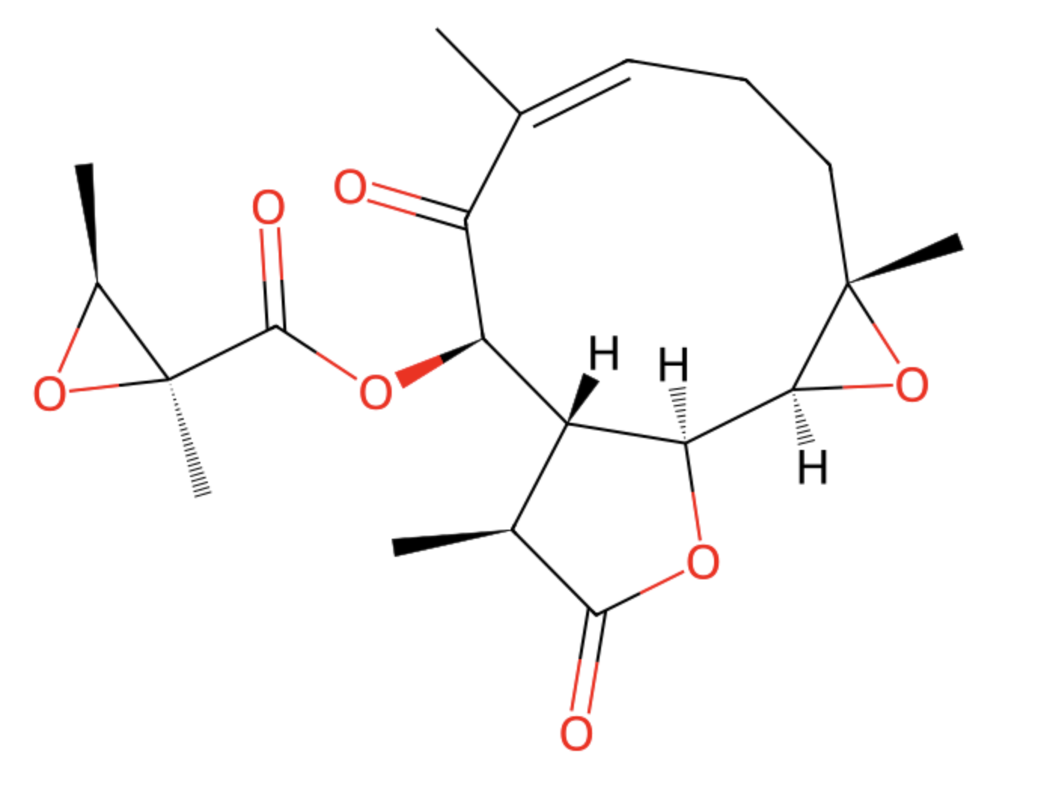
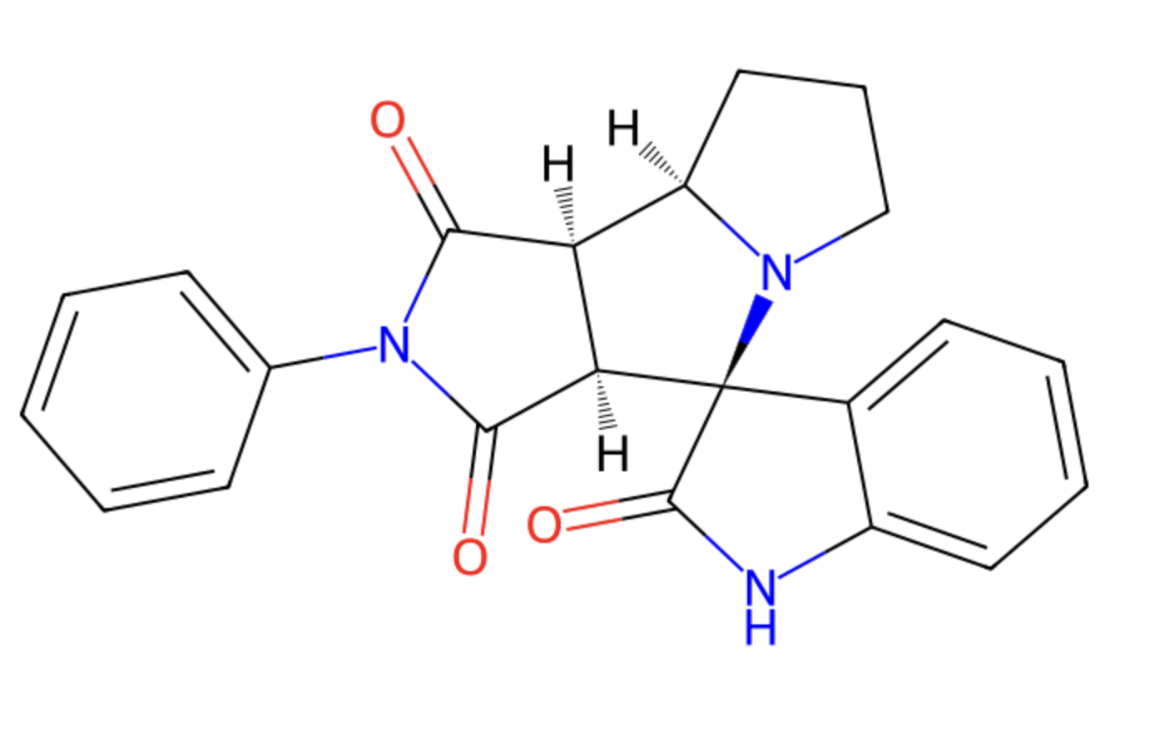
Natural product are complex and interesting molecules
30% of FDA approved drugs are sourced from natural products
Natural products have innate bioactivity
Natural-product derived specialty chemicals are widely used across many industries
[1] L. Laraia and H. Waldmann, “Natural product inspired compound collections: evolutionary principle, chemical synthesis, phenotypic screening, and target identification,” Drug Discovery Today: Technologies, vol. 23, pp. 75–82, Mar. 2017, doi: 10.1016/j.ddtec.2017.03.003.

Slide 3
Natural product generation methods can be improved

Slide 4
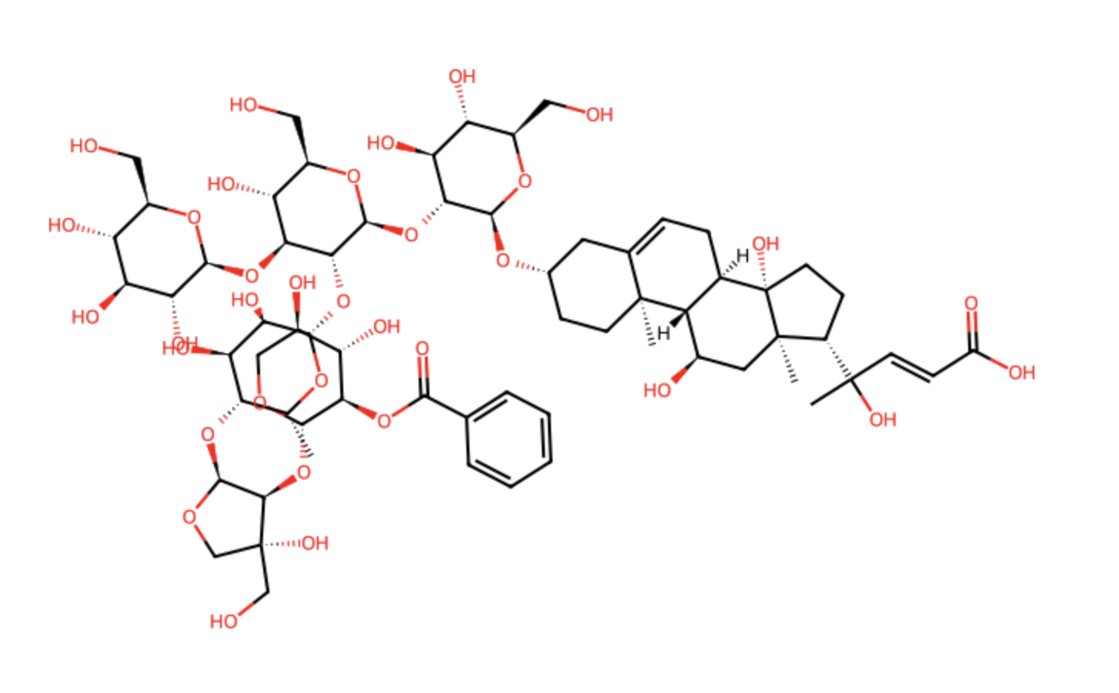
Natural product generation methods can be improved
Outputs of NP generation methods suffer from reduced validity, uniqueness, etc.
Is this real?

Slide 5

Natural product generation methods can be improved
Outputs of NP generation methods suffer from reduced validity, uniqueness, etc.
Is this real?
Generate an alkaloid
Make this more drug-like
Current natural product generation methods lack functionality.
?
no.

Slide 6

Natural product generation methods can be improved
Outputs of NP generation methods suffer from reduced validity, uniqueness, etc.
Is this real?
Generate an alkaloid
Make this more drug-like
Current natural product generation methods lack functionality.
?
no.
Goal: develop a platform for methods for NP generation and evaluation.

Slide 7
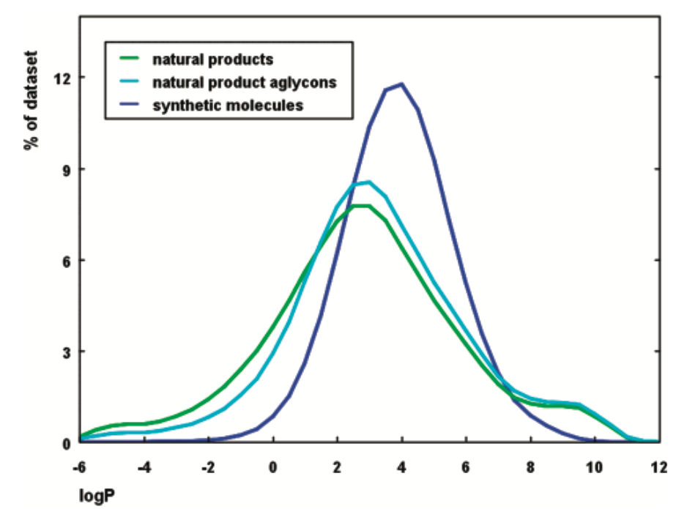
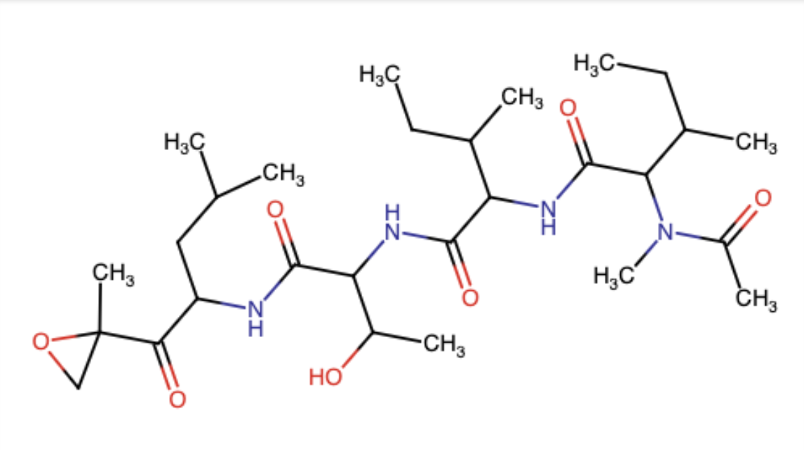
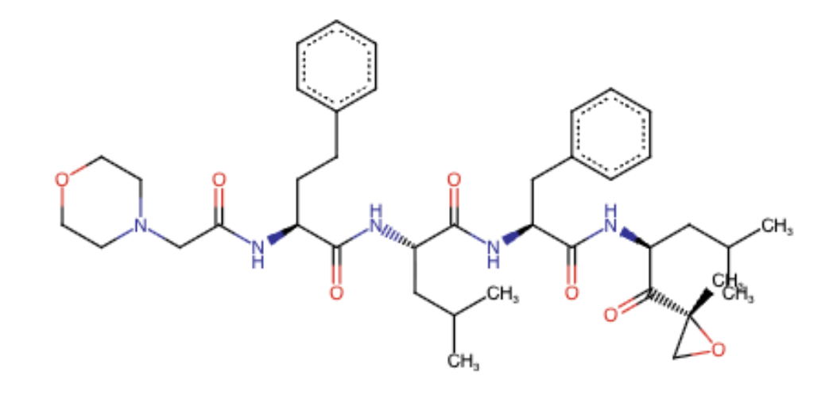
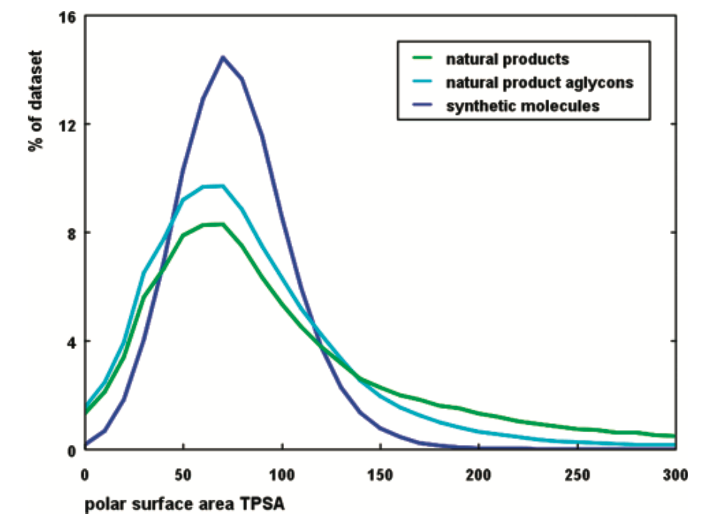
Natural Product Drug Discovery
While bioactive, NPs tend to suffer from poor drug-like properties:
Solubility, ADME profiles, oral bioavailability
?
Epoxomicin natural product
Carfilzomib
approved drug
Ertl, Peter, et al. “Natural Product-Likeness Score and Its Application for Prioritization of Compound Libraries.” Journal of Chemical Information and Modeling, vol. 48, no. 1, Jan. 2008, pp. 68–74. DOI.org (Crossref), https://doi.org/10.1021/ci700286x.

Slide 8
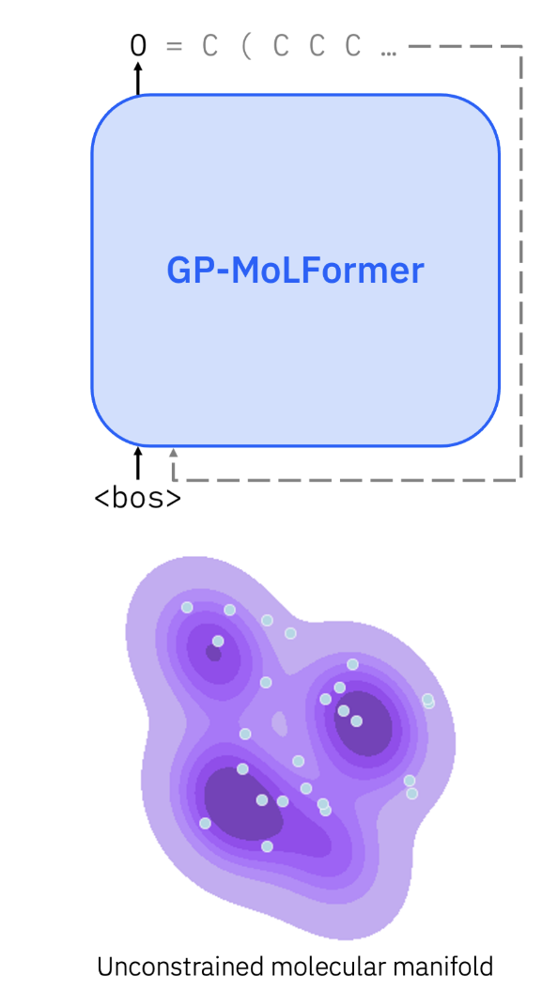
Parameter-Efficient Pair Tuning for Drug Discovery
GP-Molformer
46.8m param

Slide 9
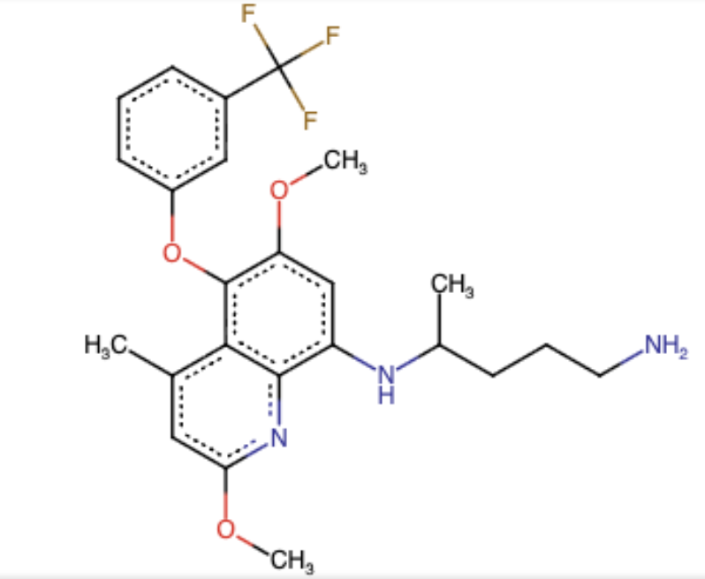
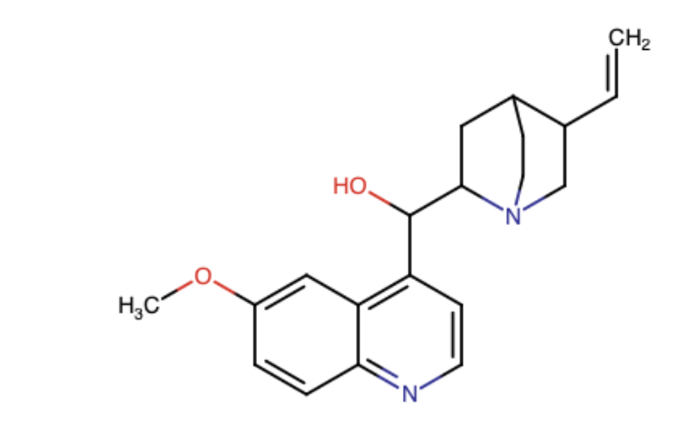
Parameter-Efficient Pair Tuning for Drug Discovery
GP-Molformer
LoRA Pair Tuning
Natural Product
Drug Analogue
46.8m param
Drug!
LoRA
+
500k param
LoRA
Natural Product
Ross, Jerret, et al. “GP-MoLFormer: A Foundation Model for Molecular Generation.” Digital Discovery, vol. 4, no. 10, 2025, pp. 2684–96. DOI.org (Crossref), https://doi.org/10.1039/D5DD00122F.

Slide 10


Parameter-Efficient Pair Tuning for Drug Discovery
GP-Molformer
LoRA Pair Tuning
Pair Generation
Natural Product
Drug Analogue
Drug-likeness by QED, SA, LogP
Similarity by morgan fingerprint
46.8m param
Drug!
LoRA
+
500k param
Validation set:
LoRA
Stone, Samantha, et al. “Cheminformatic Analysis of Natural Product-Based Drugs and Chemical Probes.”
Natural Product
Ross, Jerret, et al. “GP-MoLFormer: A Foundation Model for Molecular Generation.” Digital Discovery, vol. 4, no. 10, 2025, pp. 2684–96. DOI.org (Crossref), https://doi.org/10.1039/D5DD00122F.

Slide 11
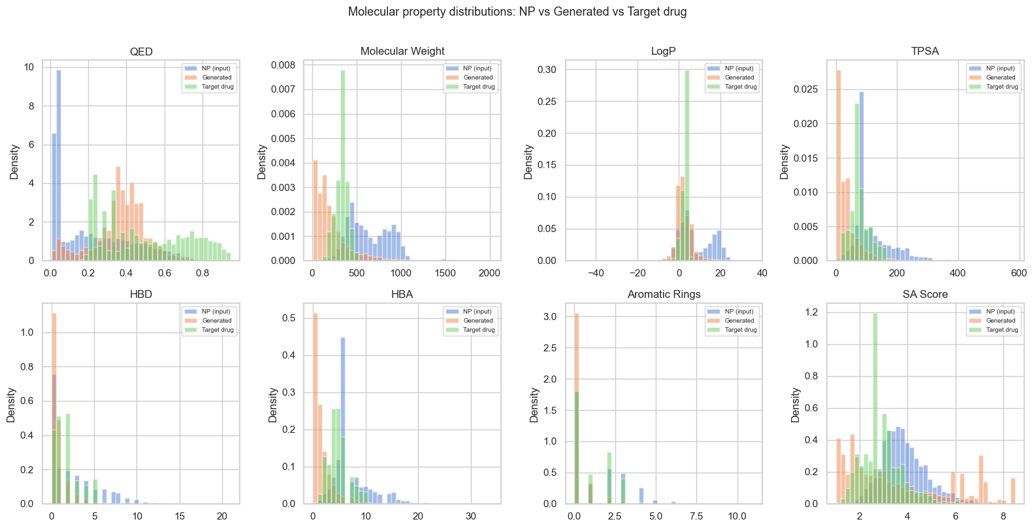
Training metrics look good…
Model might be learning the transformation?

Slide 12
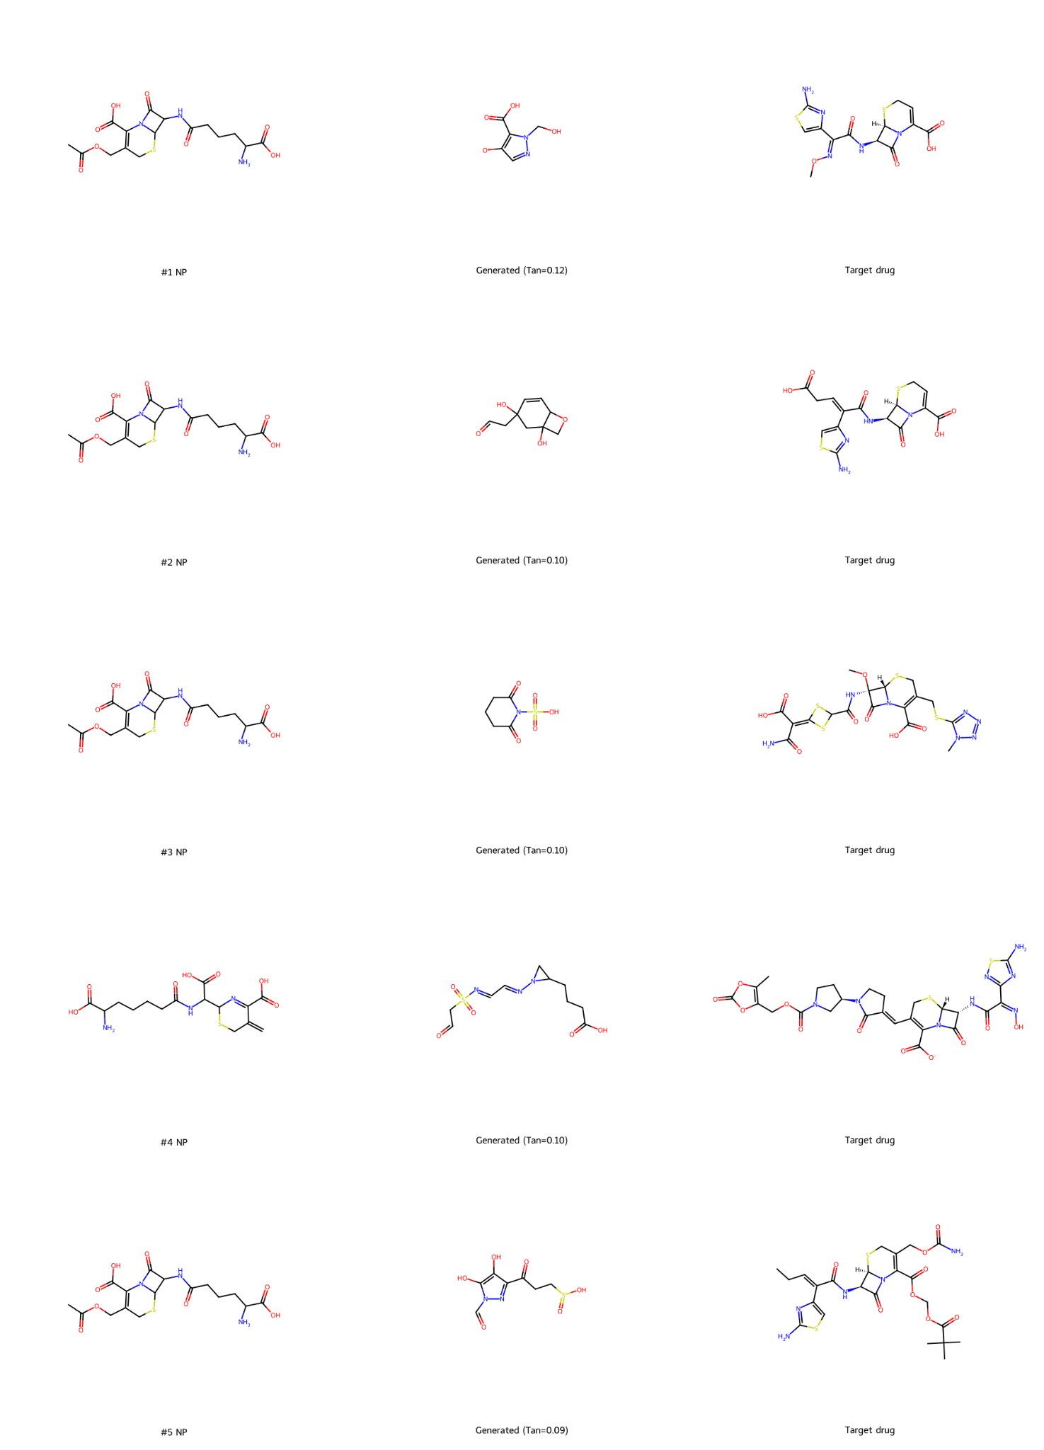
Validation fail: offset between train/test set
Natural Product
Generated
Target

Slide 13
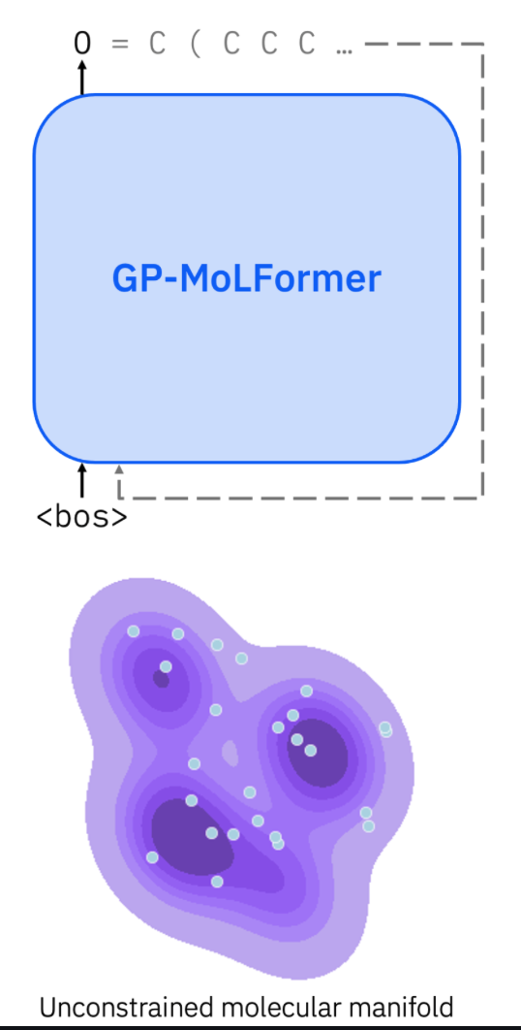
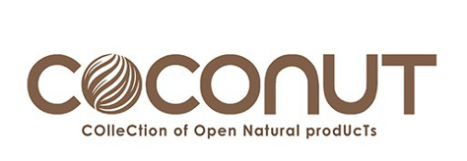
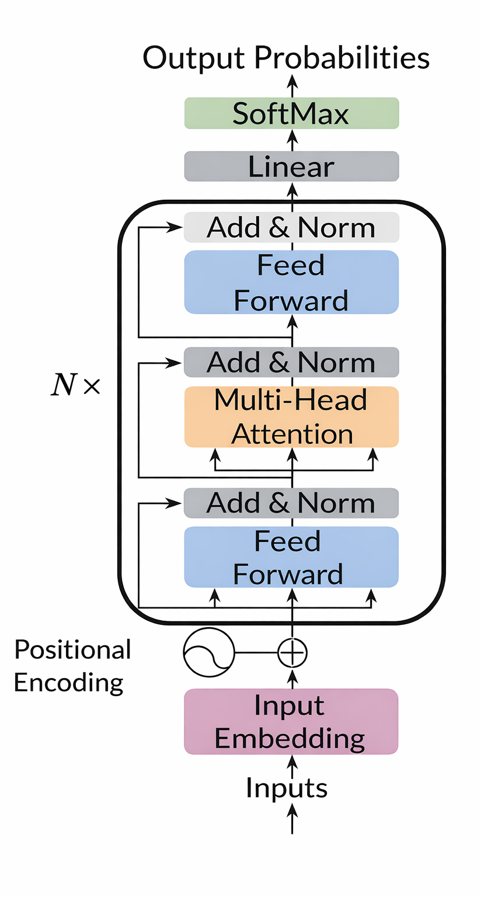
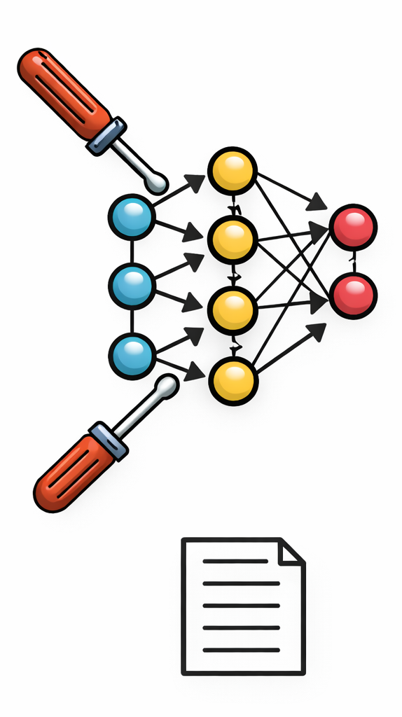
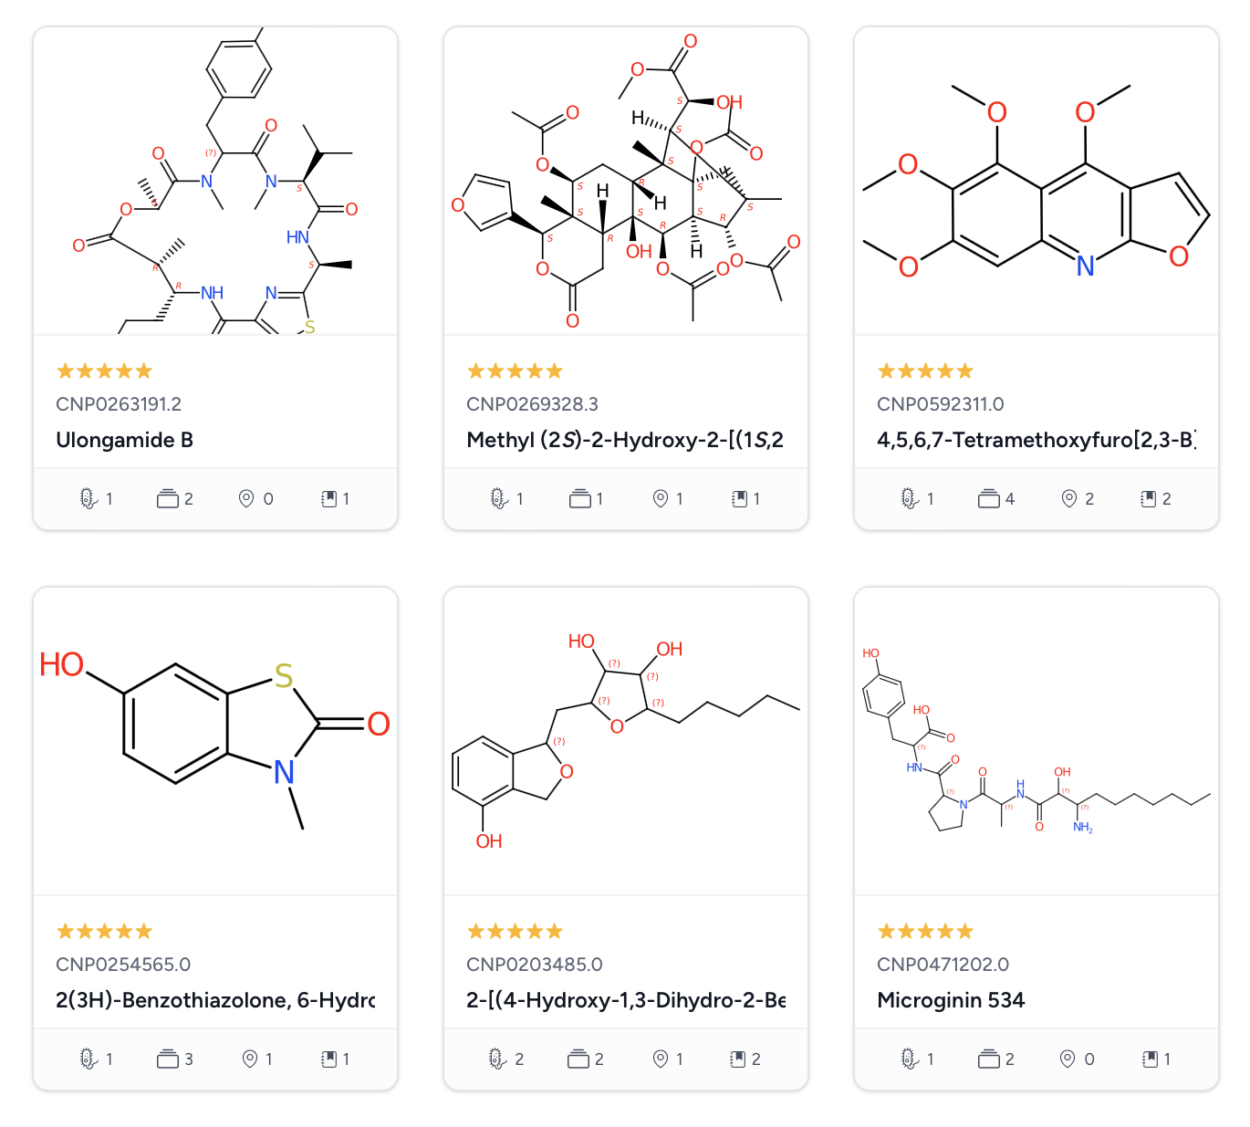
Training NPComposer - A model for controllable NP generation
Use GP-MoLFormer as pre-trained foundation model:
Transformer model pre-trained on over 1B SMILES strings
Fine-tune model on COCONUT natural product database with associated property information
fine-tuning
Ross et al., GP-MoLFormer: A Foundation Model for Molecular Generation. arXiv. 2024.
Chandrasekhar et al., COCONUT 2.0. Nucleic Acids Res., 2025. .

Slide 14
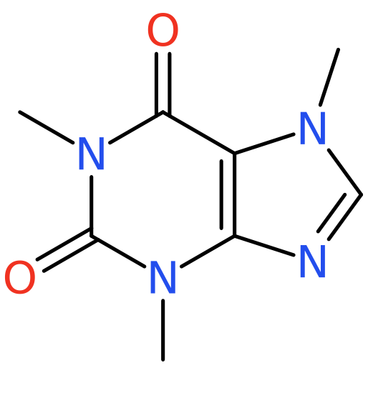
Enabling conditional natural product generation
Natural product classification and property information are added to each training example
during fine-tuning to enable conditional NP generation
One structure input:
(caffeine)
Compute property information:
Format training input:
Train model for next token prediction:
Pathway: Alkaloids
Superclass: Pseudoalkaloids
Number of aromatic rings: 2
Glycoside: False
QED drug-likeness: 0.54
Synthetic accessibility: 2.3
<property information>C
<property information>CN
<property information>CN1
<property information>CN1C
…
<pathway:Alkaloids>
<superclass:Pseudoalkaloids>
<num_aromatic_rings:2>
<contains_glycoside:False>
<qed:0.54><SA:2.3>CN1C(=O)C2=C(N=CN2C)N(C)C1=O
SMILES:
CN1C(=O)C2=C(N=CN2C)N(C)C1=O

Slide 15
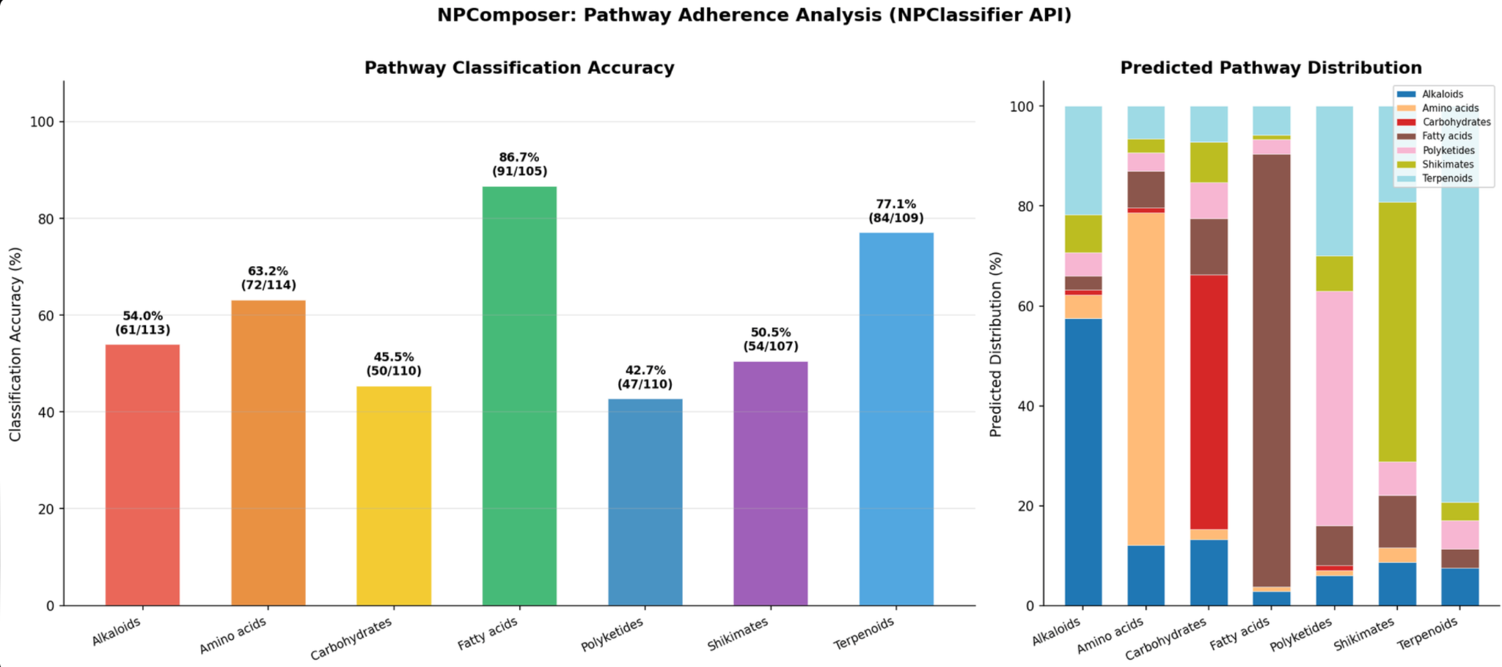
Evaluating conditional NP generation (pathway classes)
NPComposer enables controllable natural product generation through user prompts.

Slide 16
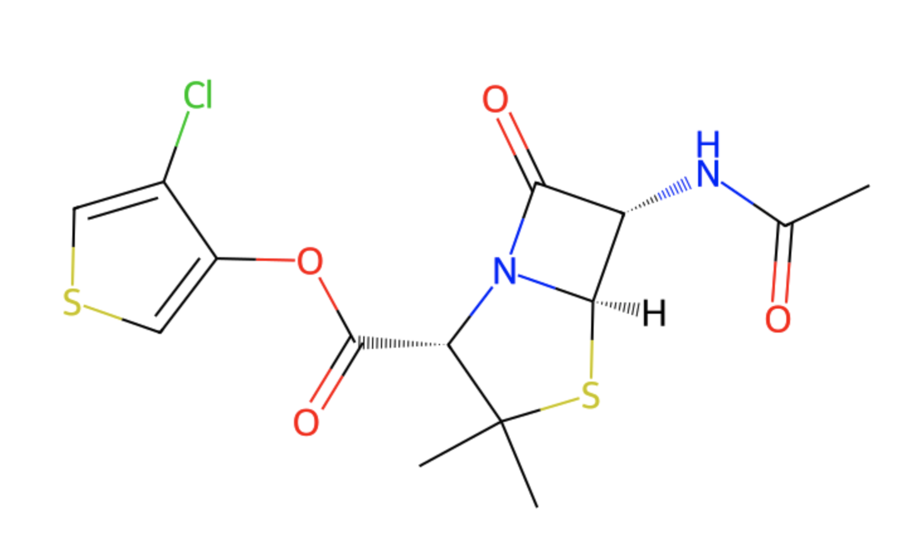
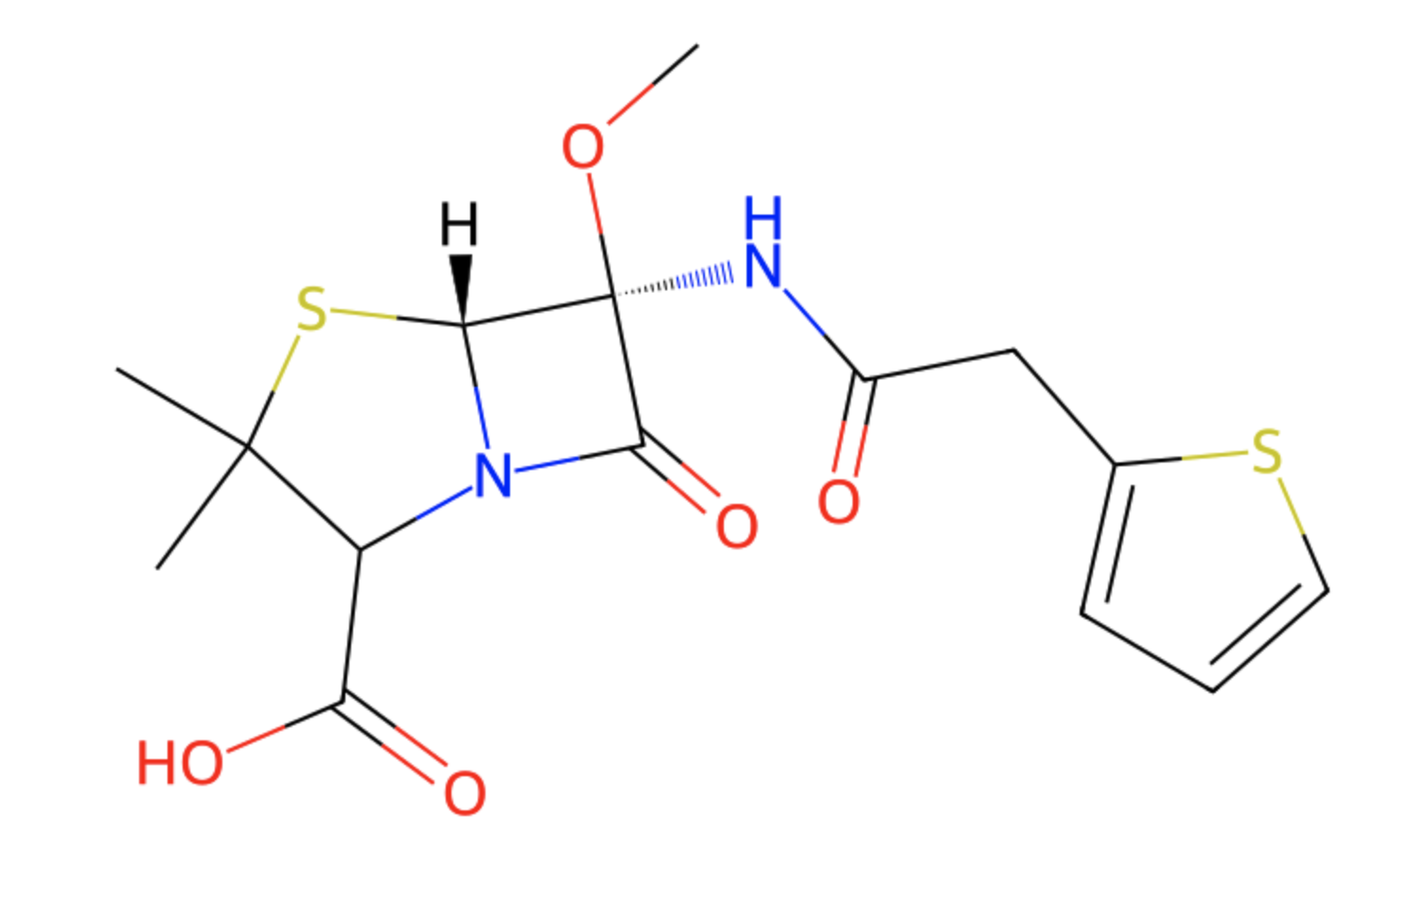
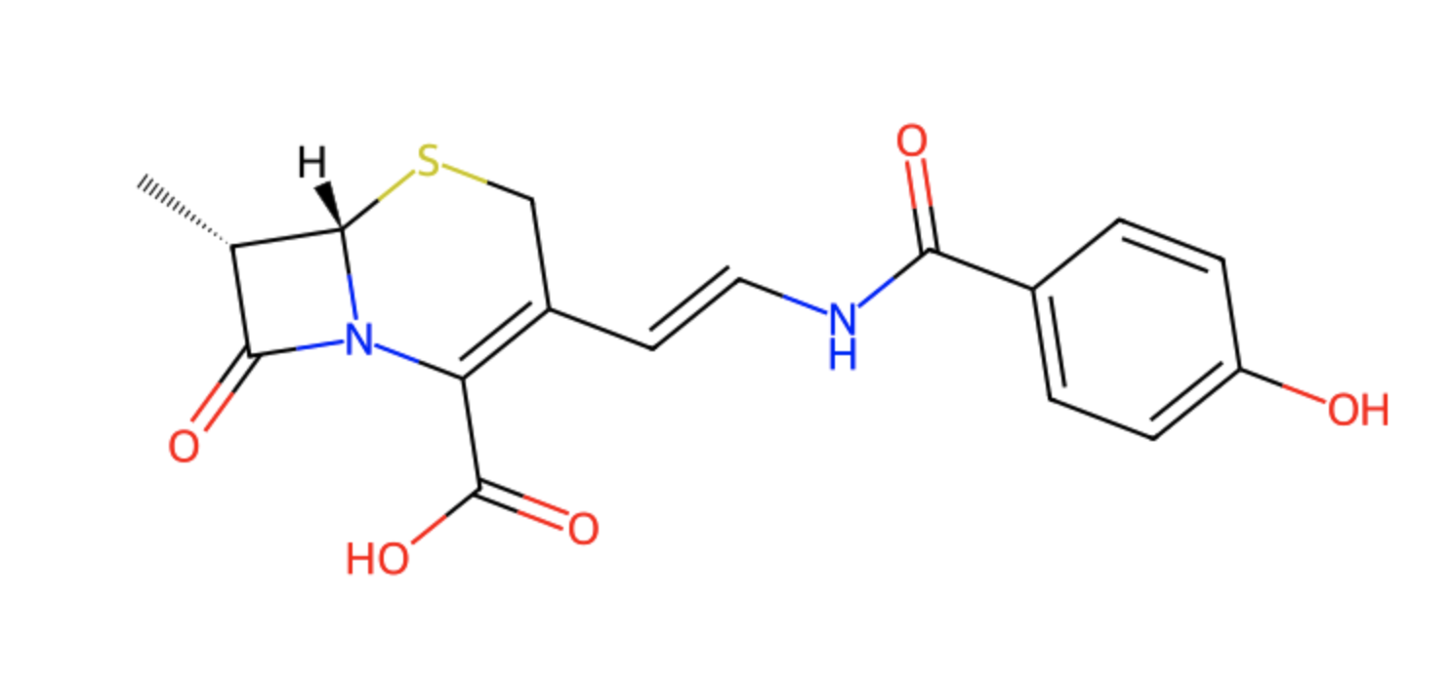
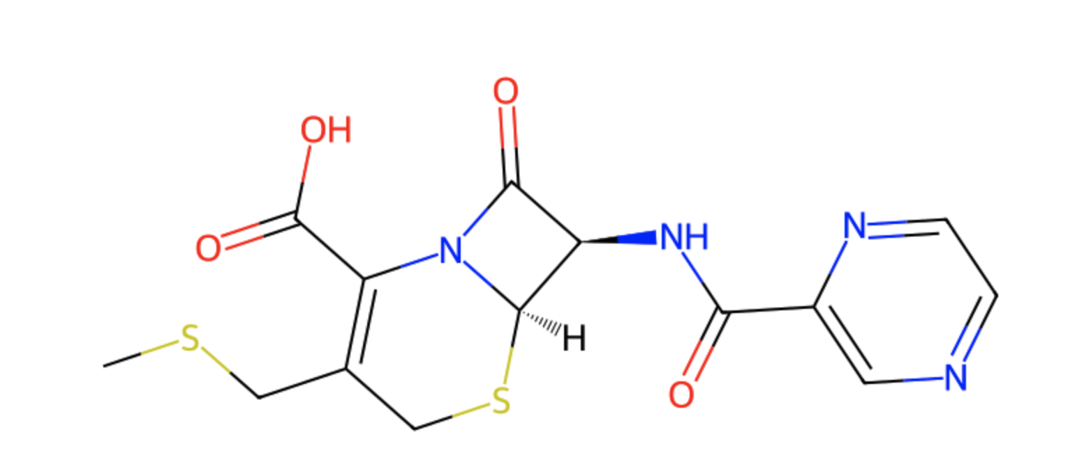
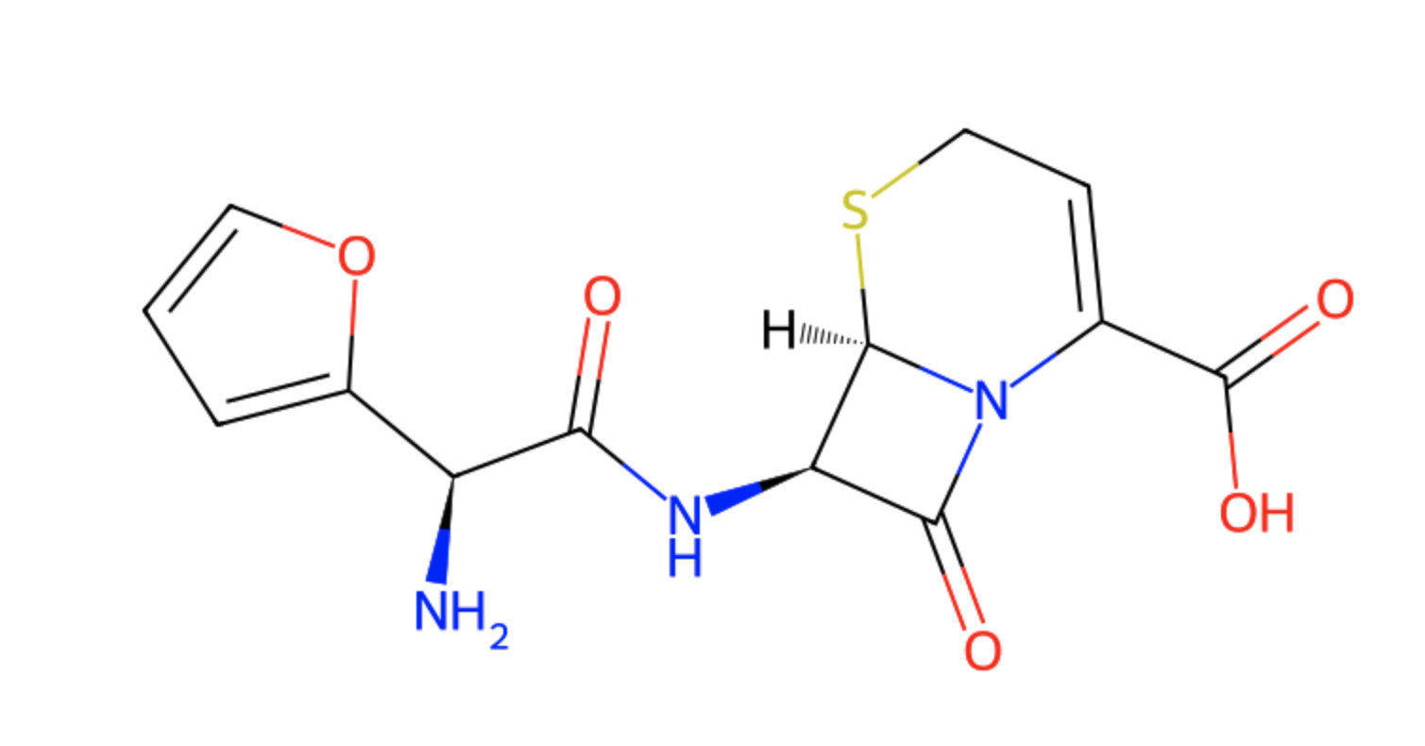
NPComposer can satisfy complex user prompts
Prompt: <np_superclass: beta-lactams> <num_aromatic_rings: 1> <contains_glycoside: False> <qed: 0.6-0.7> <SA: 3-4>
QED: 0.70
SA score: 3.6
QED: 0.64
SA score: 4.0
QED: 0.60
SA score: 3.8
QED: 0.65
SA score: 3.9
QED: 0.70
SA score: 3.5
QED: 0.62
SA score: 3.8
*Novel molecules - no matches in COCONUT or PubChem

Slide 17
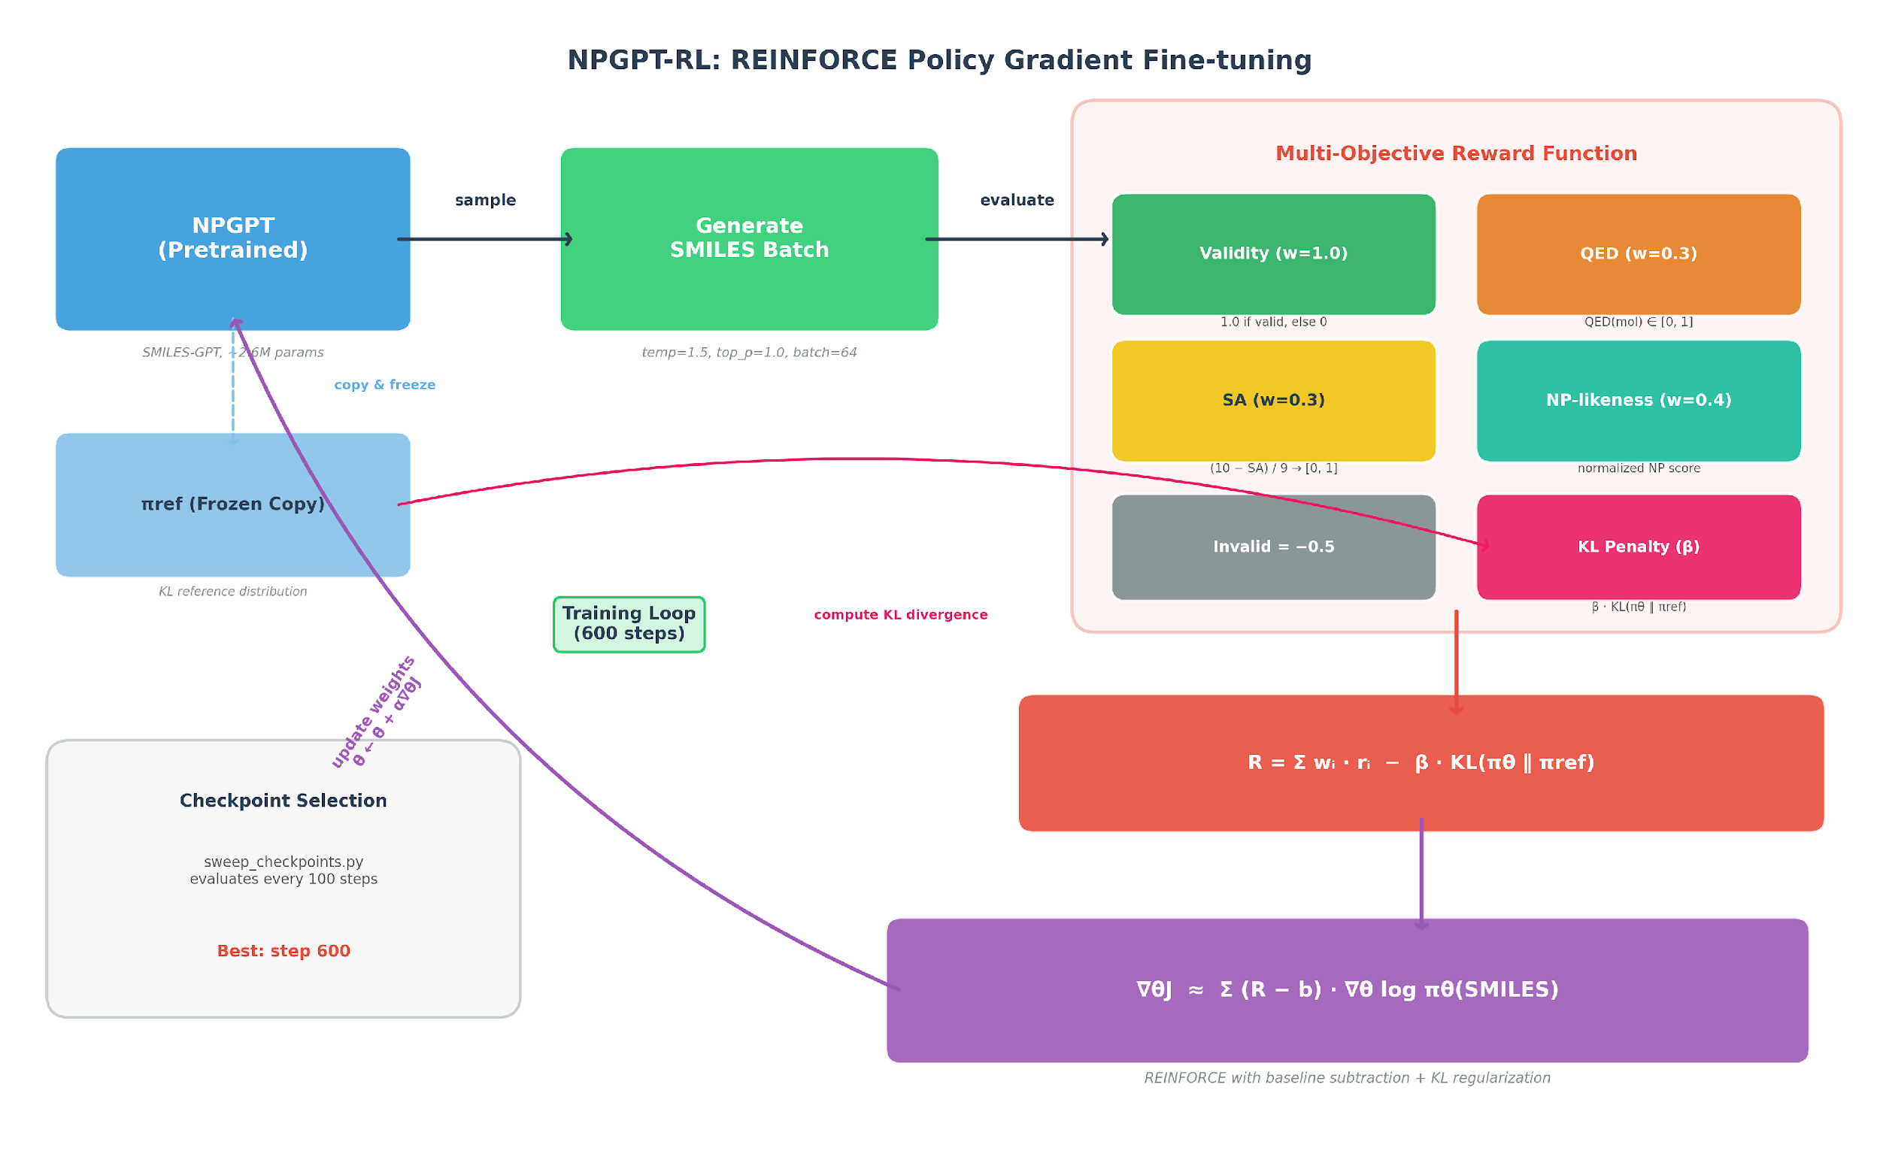
NPGPT-RL: Reinforcement Learning Fine-tuning
Applying REINFORCE policy gradient to optimize NPGPT for drug-like natural products
Multi-Objective Reward
Component | Weight | Range
Validity | 1.0 | {0, 1}
QED (drug-likeness) | 0.3 | [0, 1]
SA (synthesizability) | 0.3 | [0, 1]
NP-likeness | 0.4 | [0, 1]
Invalid penalty | -0.5 | fixed
REINFORCE Loss with KL Regularization
L = -log p(a|s) * (R - b) + B * KL(p || p_ref)
b = E[R]
baseline for variance reduction
Frozen prior (p_ref) prevents mode collapse | Experience replay for sample efficiency | Best checkpoint: step 600
Thomas et al., REINFORCE-ING Chemical Language Models for Drug Discovery, JCIM 2025
Notes:
Now, let me walk you through our RL fine-tuning approach — NPGPT-RL.
We start with NPGPT, which is 2.6-million parameter GPT model pretrained on the COCONUT natural product database. We then apply the REINFORCE policy gradient algorithm to optimize it for generating better molecules.
On the left, you can see the training pipeline. At each step, the model generates a batch of SMILES strings, and we evaluate them with our multi-objective reward function — shown in the table on the right.
The reward has four components: validity gets the highest weight at 1.0 since generating valid molecules is the most basic requirement. Then we have QED for drug-likeness, SA score for synthetic accessibility, and NP-likeness to keep the molecules natural-product-like. Invalid molecules get a penalty of minus 0.5.
The loss function is standard REINFORCE with two important additions: a baseline — the running mean of rewards — for variance reduction, and a KL divergence term against a frozen copy of the pretrained model to prevent mode collapse. The best checkpoint was found at step 600.

Slide 18
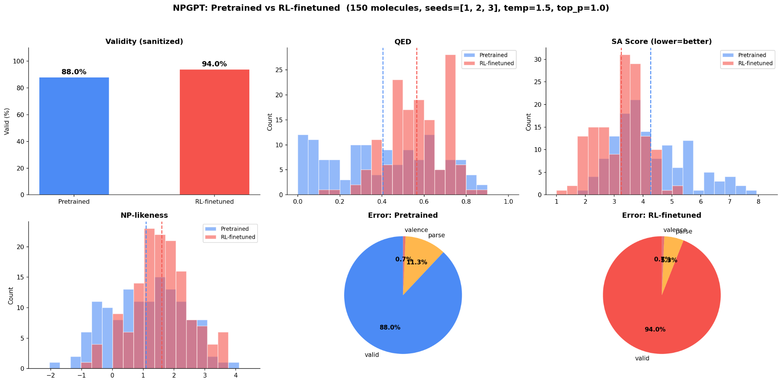
NPGPT-RL improves molecular properties
Comparison of pretrained NPGPT vs RL-finetuned (50 molecules x 3 seeds)
Validity
94%
from 88%
QED
+40%
drug-likeness **
SA Score
-24%
easier to synthesize **
Metric | Pretrained | RL-finetuned
Validity | 88% | 94%
QED | 0.404 | 0.566
SA Score | 4.26 | 3.24
NP-likeness | 1.09 | 1.60
Novelty | 0.757 | 0.893
NP-likeness
+47%
more NP-like *
Novelty
+18%
new molecules
* p < 0.05, ** p < 0.01 (Welch t-test, 3 seeds)
Validity: % of valid SMILES | QED: drug-likeness [0-1] | SA: synthetic accessibility [1-10, lower=easier] | NP-likeness: natural product similarity [-5 to 5] | Novelty: % not in training set
Notes:
So does RL actually help Absolutely
Here we compare the pretrained NPGPT against the RL finetuned version evaluated on 50 molecules across 3 random seeds
On the left you can see the histograms and comparison table and on the right the key improvements are highlighted
Validity jumped from 88 percent to 94 percent QED drug likeness improved by 40 percent which is statistically significant at p less than 0.01 SA score decreased by 24 percent meaning the molecules became significantly easier to synthesize NP likeness increased by 47 percent so the molecules are more natural product like And novelty increased by 18 percent meaning fewer duplicates from the training set
So across every single metric RL fine tuning led to meaningful improvements and most of these are statistically significant

Slide 19
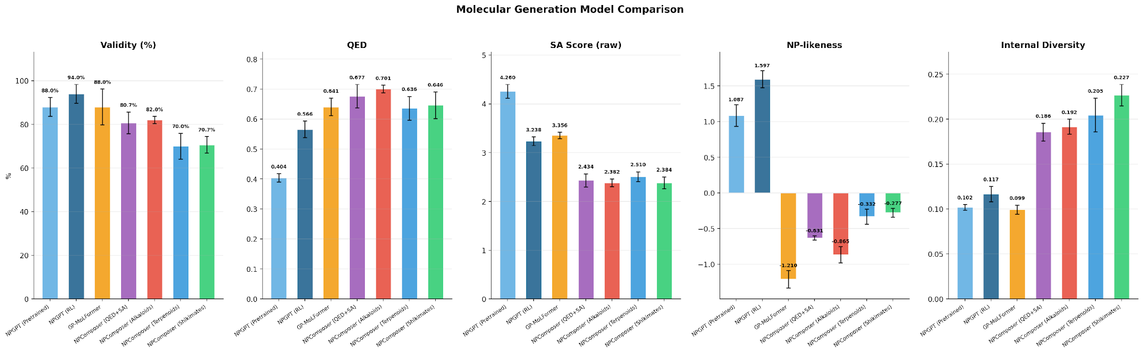
Multi-model performance comparison
GP-MoLFormer
NPGPT-RL
NPComposer
46.8M params
2.6M + RL
46.8M + SFT
Foundation model pre-trained on 1B SMILES. High QED drug-likeness but low NP-likeness.
RL-optimized for multi-objective rewards. Best validity (94%) and NP-likeness.
Conditional generation with pathway/QED/SA tokens. Best QED, SA scores and structural diversity.
Notes:
Now lets zoom out and compare all the models in our platform
This chart shows five metrics across seven model configurations Let me highlight the key takeaways
GP MoLFormer the 46 point 8 million parameter foundation model achieves the highest QED at 0 point 64 but its NP likeness is actually negative meaning it generates generic drug like molecules rather than natural products
NPGPT RL our RL model achieves the best validity at 94 percent and the highest NP likeness at 1 point 6 confirming that RL successfully pushes the model toward natural product space
NPComposer with QED and SA conditioning has the best SA score at 2 point 4 and the highest structural diversity at 0 point 19 showing the power of conditional generation
And with pathway conditioning like Alkaloids NPComposer achieves 85 percent pathway classification accuracy meaning it reliably generates the type of molecule you ask for
So each model has its strengths GP MoLFormer for drug likeness NPGPT RL for NP likeness and validity and NPComposer for controllability and diversity

Slide 20
NPComposer: An Open Platform for NP Generation
A unified, automated framework where anyone can develop, train, and evaluate NP generation models
Databases
Processing
Models
Evaluation
Generation
COCONUT 715K
NPASS 203K
NP-Drug 3K
K-means subset
SA/QED filter
Train/Val/Test
NPComposer
NPGPT-RL
GP-MoLFormer
NPGPT
Validity, QED, SA
NP-likeness
Pathway accuracy
Conditional
Unconditional
Visualization
Automated Pipeline
Extensible Models
Comprehensive Eval
Open Source
make setup -> download -> pipeline -> train -> evaluate — one-command workflow
Add your own model: implement generate() and plug into unified evaluation
Validity, QED, SA, NP-likeness, diversity, novelty, pathway classification
GitHub: shawnralyn/NPComposer — MIT-licensed, contributions welcome
Notes:
Finally all of this comes together in the NPComposer platform
The pipeline flows from left to right we start with three natural product databases COCONUT with 715K molecules NPASS with 203K and NP Drug with 3K known drug molecules These go through data processing K means subsetting filtering and splitting Then we support multiple models NPComposer NPGPT RL GP MoLFormer and NPGPT All models feed into a unified evaluation suite measuring validity QED SA NP likeness and pathway accuracy And finally generation both conditional and unconditional with built in visualization
The key point this entire pipeline is automated One command make setup through make evaluate handles everything Its extensible you can add your own model by just implementing a generate function And its open source on GitHub Thank you

